Slide 1


Образовательная электронная система
Foxhound team

Slide 2
TEAM FOXHOUND
Nedogarok Anton
С++/Qt/QML, ML/Keras, Python
Bogachev Maxim
Frontend, Bootstrap, JS
Petrov Anton
Frontend, Bootstrap, JS
Semennikov Kirill
Python/Flask/Pandas, Frontend, C++, cybersec.
Soldatov Vyacheslav
Frontend, Backend

Slide 3
PROJECT GOALS
Adaptive educational track
Individual and team motivation, competitive spirit
Gamification
Automation of tutor’s work
Cute place, where want to return again and again

Slide 4
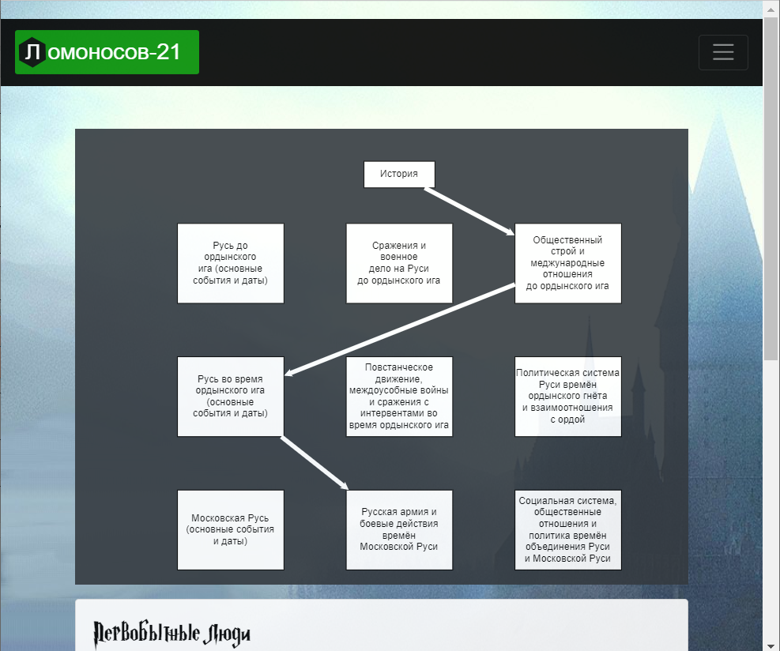
WHAT’S DONE
Adaptive track

Slide 5
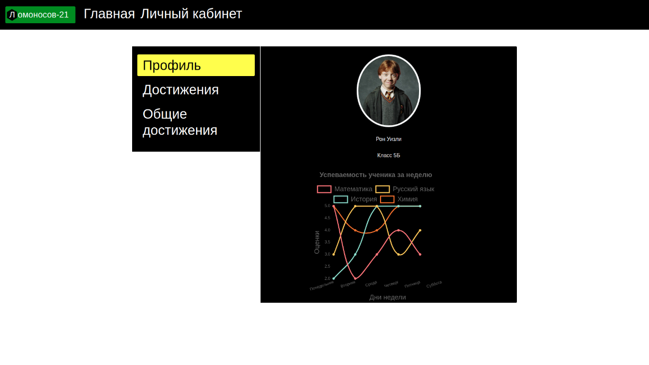
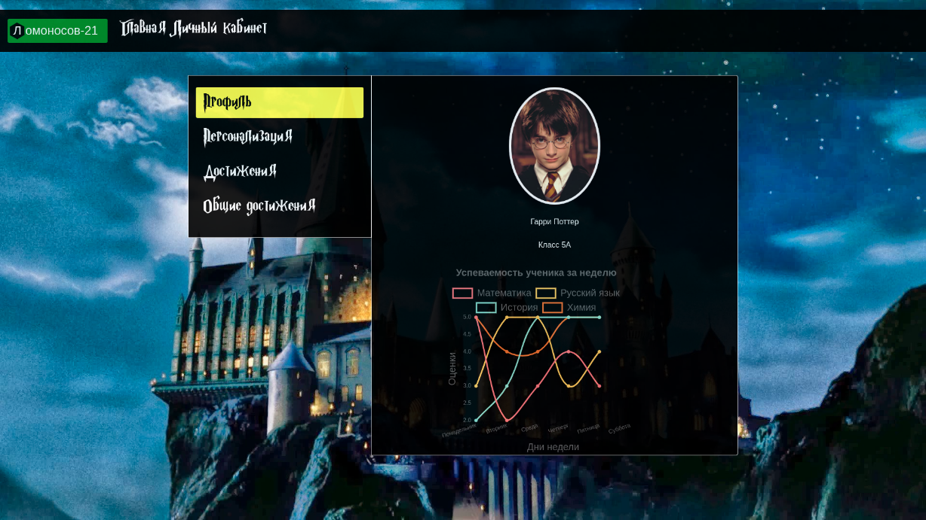
WHAT’S DONE
Individual motivation. Allow page customization and skins for pupils with greater progress
VS

Slide 6
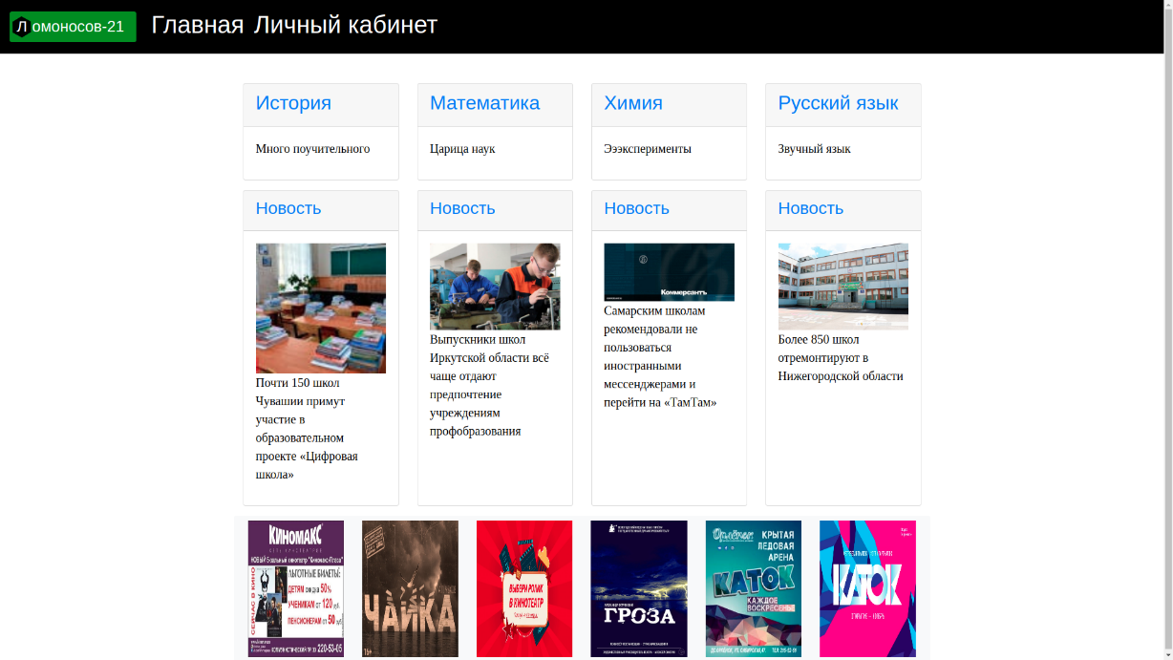
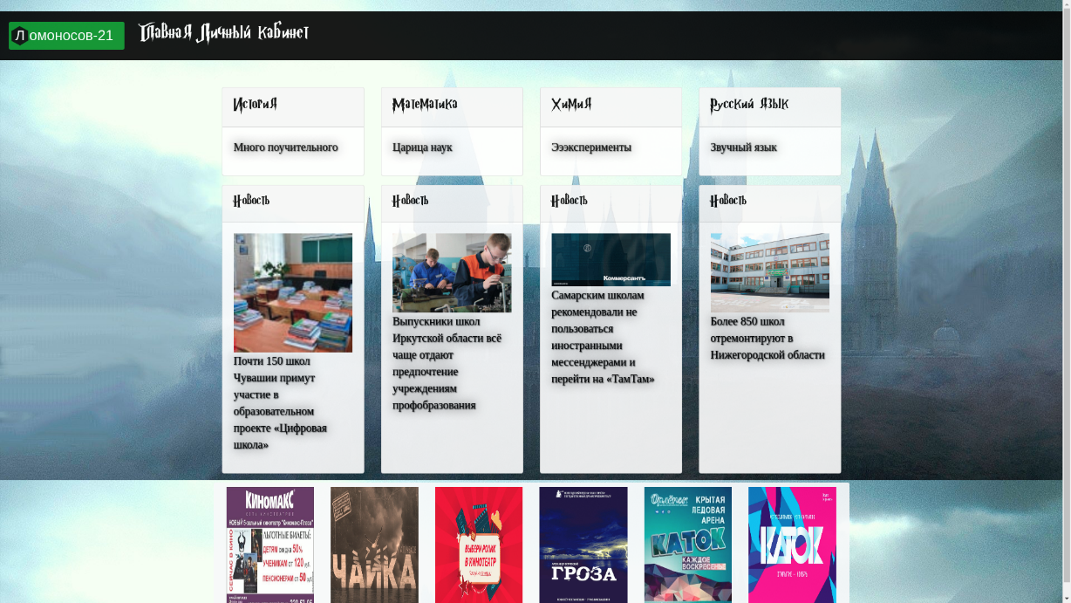
WHAT’S DONE
Individual motivation. Allow cute customization for pupils with greater progress
VS

Slide 7
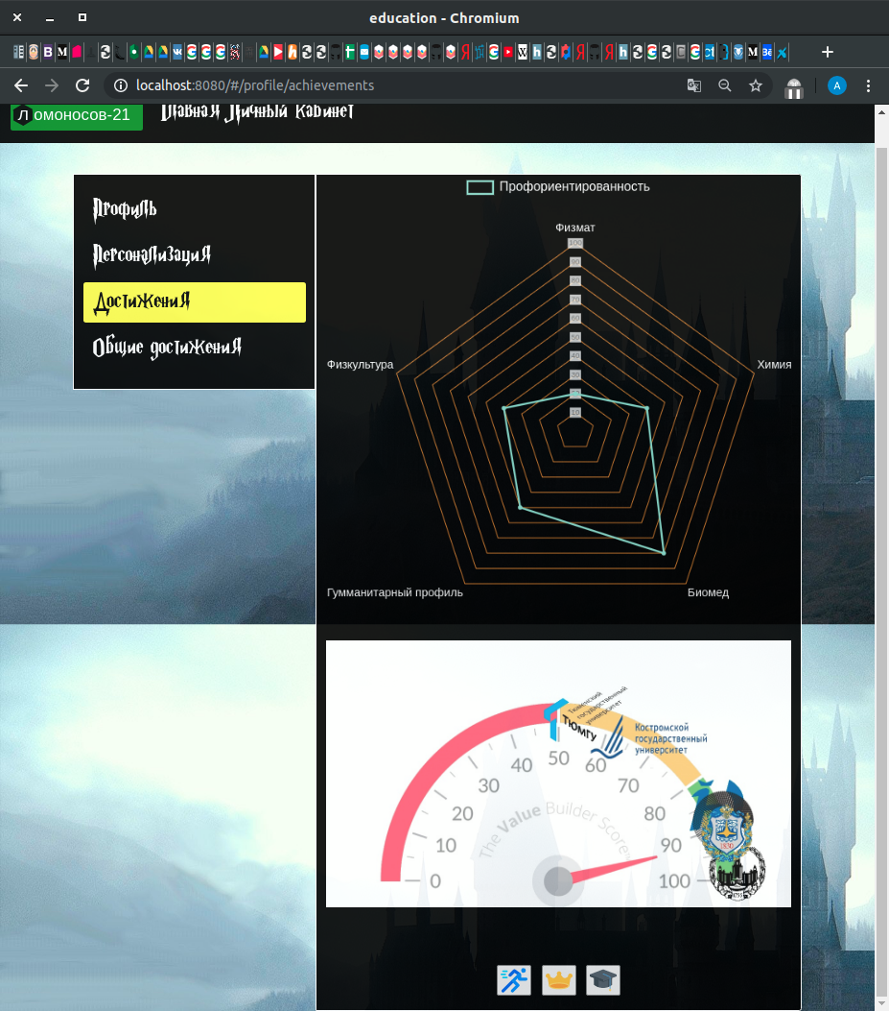

WHAT’S DONE
Individual motivation. Game-like stats.

Slide 8
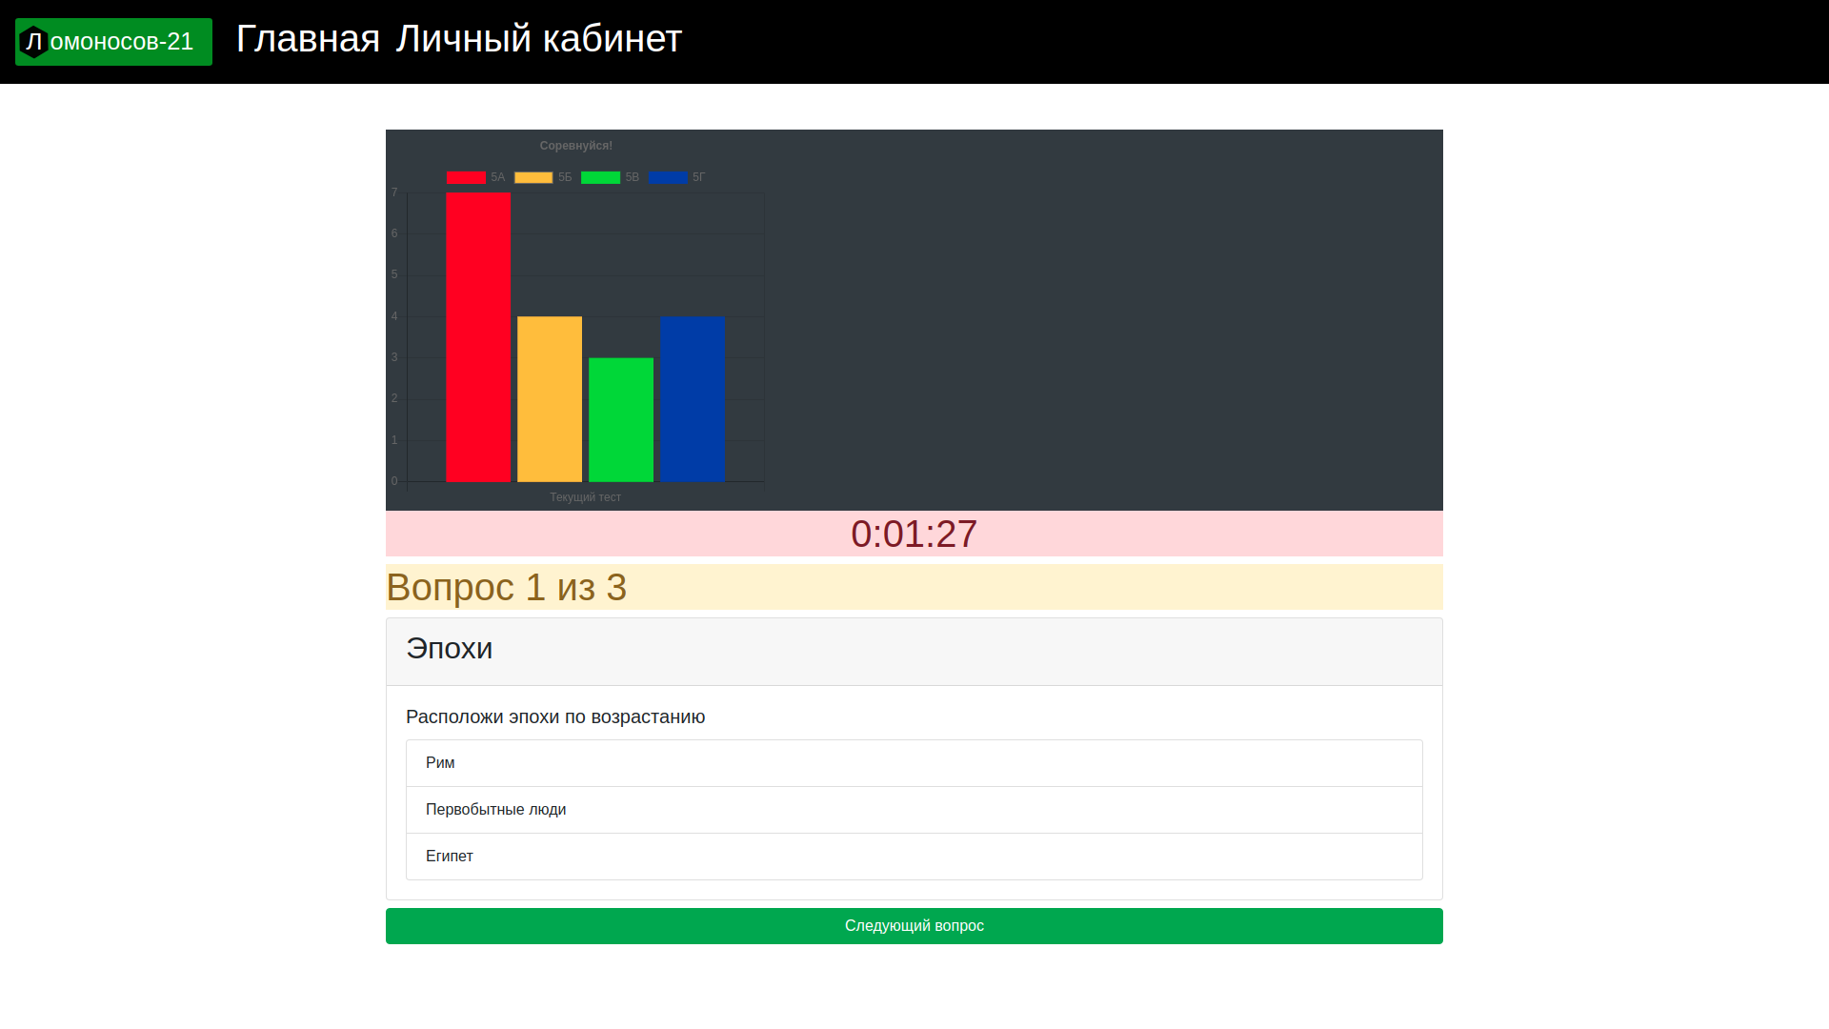
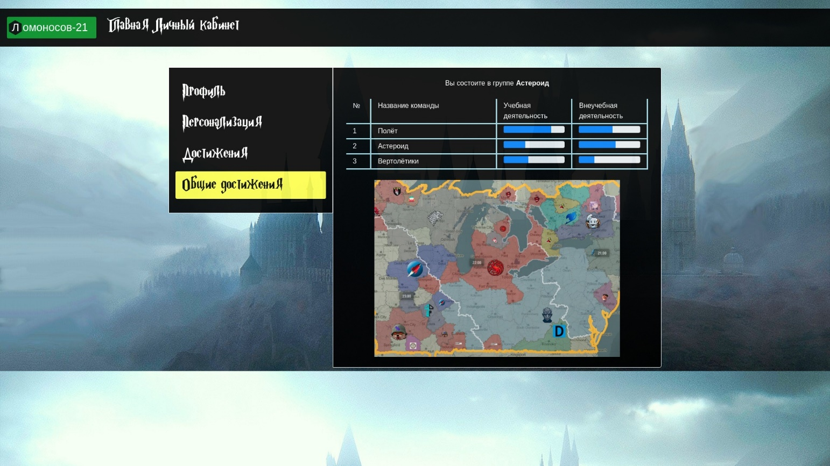
WHAT’S DONE
Teamwork motivation by competing between «clans».

Slide 9
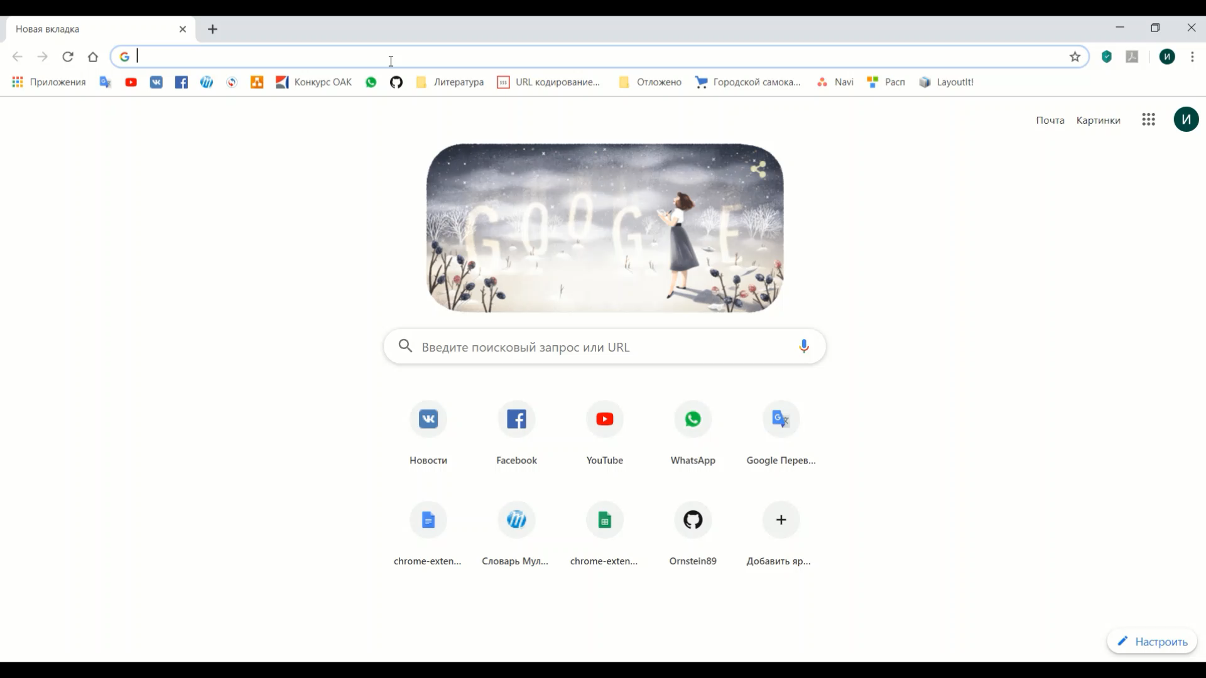
WHAT’S DONE
Demo video in file Lomonosov21Demo.mp4

Slide 10
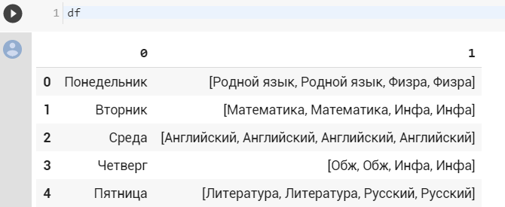
WHAT’S DONE
Teacher’s backend partially implemented on http://91.245.227.86/api/plans.
Schedule-generation algorithm shown in Jupyter Notebook (Google Colab link).

Slide 11












STACK

Slide 12
BUSINESS PLAN
6 mnth.
2 years
Pre Seed Inv. 75 000$
R&D
Testing
Release
Market entry
Seed
Investment 75 000$
Grow market share
Customer support
Features R&D
Reach payback
Payback
Profit >125 000$/month

Slide 13
MONETIZATION
School subscription per each school student 0,3$/mnth (20 р/мес.)
Advertising on the platform for 100$/mnth (10 000 р/мес.)
Extra educational content

Slide 14
WHAT IS TO BE DONE…
Mobile app
Tutors and admin’s portal

Slide 15

REPOSITORY
https://github.com/Ornstein89/FoxhoundTeam_MoscowHack2019

Slide 16

TEACHER’S PORTAL
http://91.245.227.86:8081/

Slide 17

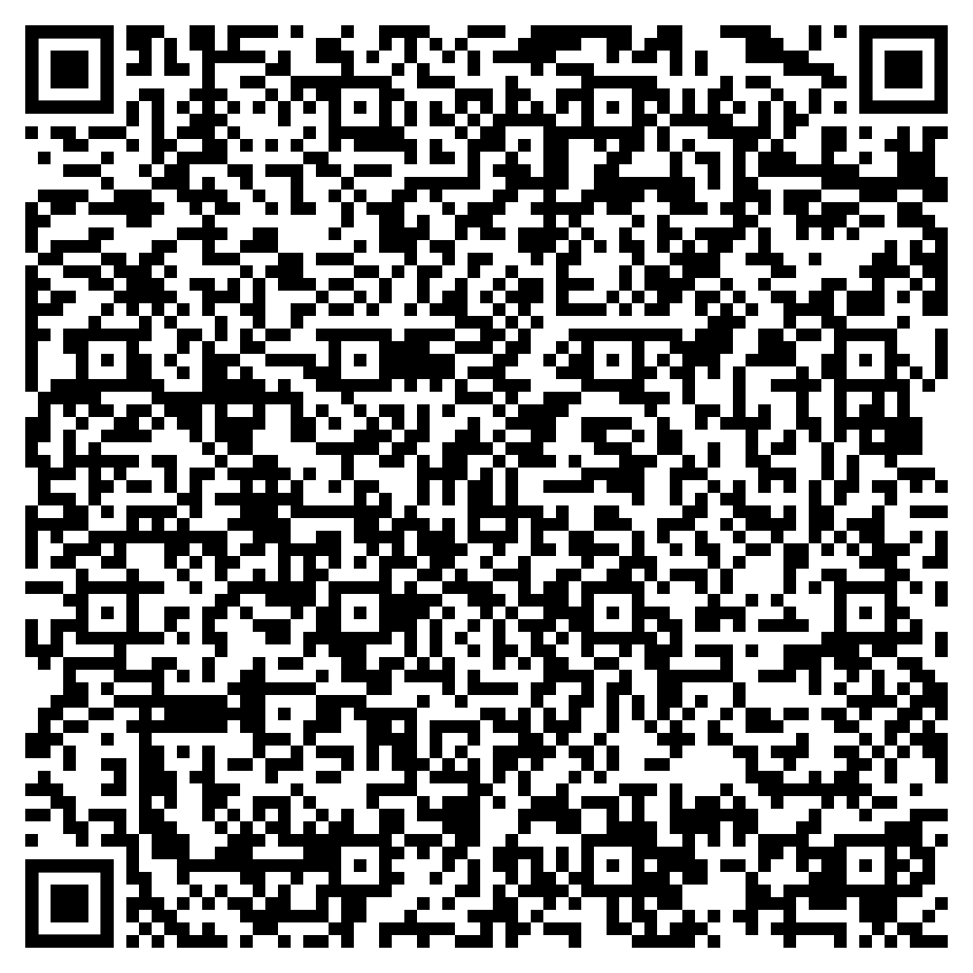

HIRE US, WE CAN MUCH MORE
+7(929)609-04-69
nk260an@gmail.com
FOXHOUND TEAM

